Slide 1
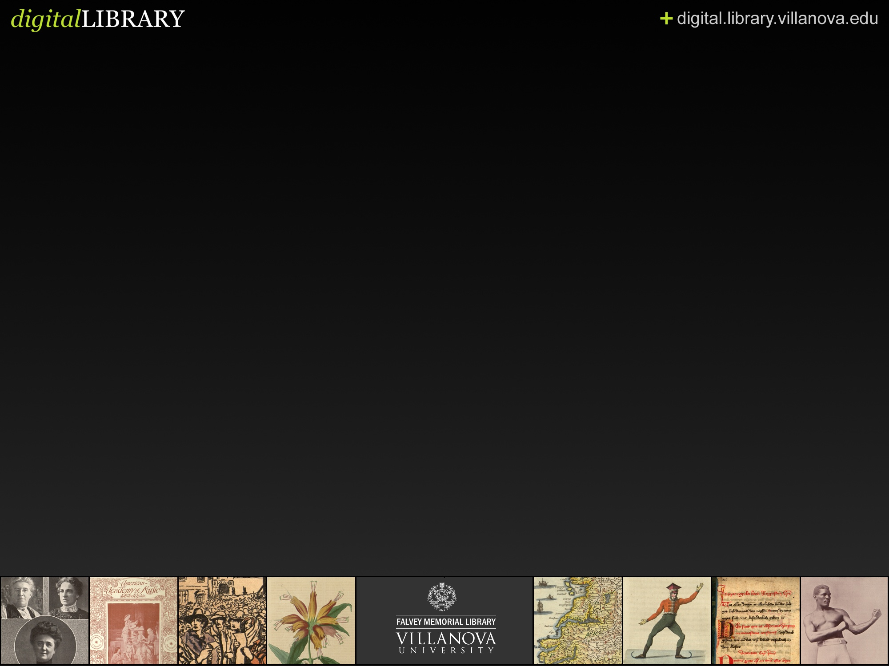
Home-Grown Digital Library System
Built Upon Open Source XML Technologies and Metadata Standards
David Lacy
Villanova University
david.lacy@villanova.edu

Slide 2
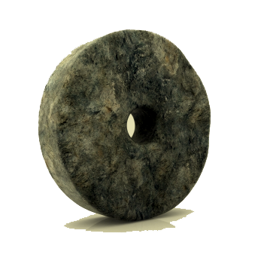
Why Did We Do This?

Slide 3
Seriously, Why Did We Do This?

Slide 4
System Components
A METS Metadata Editor
A series of batch-process service image generation tools
An XML Database repository
A file server
An OAI server
A series of VuFind Record Drivers

Slide 5
Architecture Components
METS XML
eXist-db
Orbeon Forms (Xforms Processor)
Tesseract (OCR)
Imagemagick

Slide 6
METS
(Metadata Encoding and Transmission Standard)
<metsHdr>
<dmdSec>
<amdSec>
<fileSec>
<structMap>
<structLink>
<behaviorSec>

Slide 7
Orbeon Forms
(XML & XForms Processor)
Browser independent, plugin free, XForms Processor
AJAX driven interface controls
XML Database (eXist) integration
XML pipeline (XPL) engine for processing XML

Slide 8
XPL Pipelines
Vocabulary for describing a processing model for XML
  File System Controls
  XQuery Submissions
  Session Management

Slide 9
<xforms:submission>
<xforms:trigger>
<xforms:action ev:event=”DOMActivate”>
<xforms:submission id="batch-attach-submission"
method="post"
replace="none"
ref="instance('rename-file-instance')"
action="/rename-file.xpl"
>
<error handling stuff>
</xforms:submission>
</xforms:action>
</xforms:trigger>

Slide 10
XPL File Processor
<p:processor name="oxf:xslt">
<p:input name="data" href="#instance"/>
<p:input name="config">
<xsl:stylesheet version="2.0">
<rename>
….
Filename
Directory
New Filename
New Directory
</rename>
</xsl:stylesheet>
</p:input>
<p:output name="data" id="rename-info"/>
</p:processor>
<p:processor name="oxf:file">
<p:input name="config" href="#rename-info" />
</p:processor>

Slide 11
Collection Development
Special Collections Material
Strategic Partnerships
Catholica
United States Irish History
Regional History
Faculty and Alumni Scholarly Material
> 9000 items

Slide 12
(Rapid) Work-flow
Select item
Scan TIFFs
Process service images
Instantiate Digital Item
Batch-Attach TIFFs and Service Images
Add Metadata
Index into VuFind

Slide 13
Service Images
Process Scanned Images (Cron)
  OCR (Tesseract)
Produce Service Images (ImageMagick)
  Large
  Medium
  Thumbnail

Slide 14
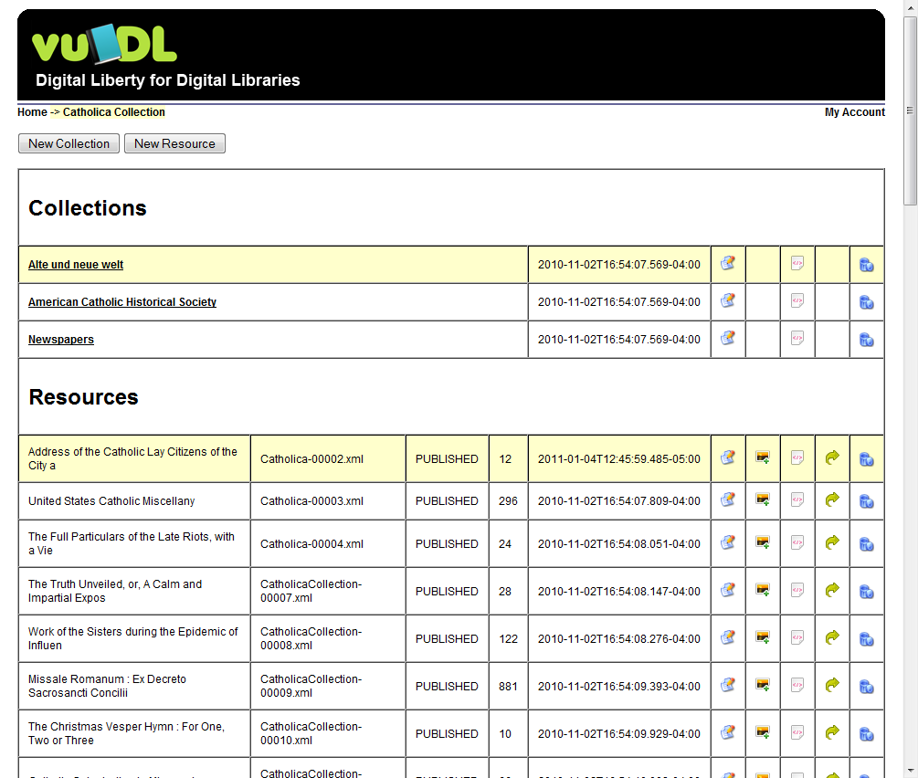
Collection View
Add Collections
Add Resources / Items
Edit Metadata
Batch-Attach Files
View Raw METS XML
Relocate Item
Delete Item

Slide 15
Resources and Collections View

Slide 16
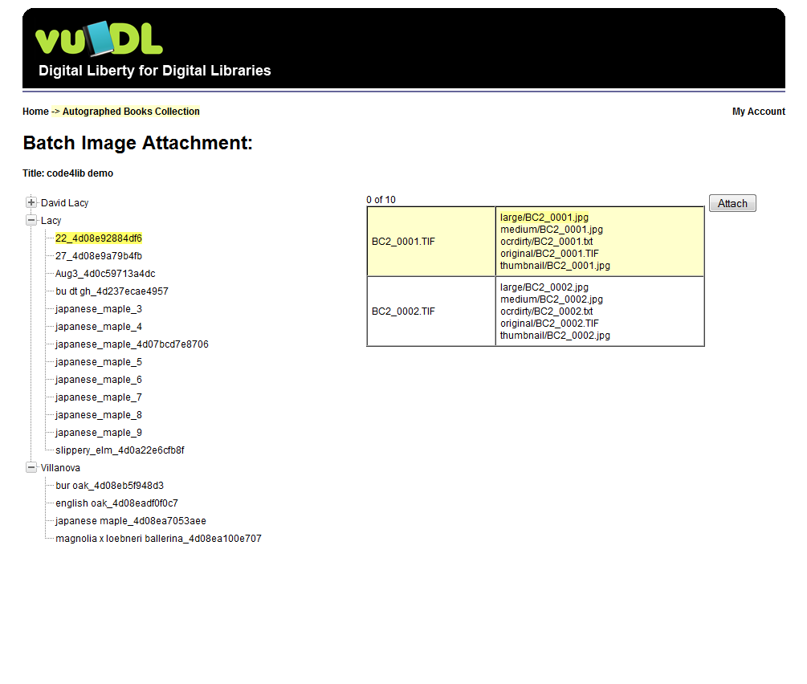
Batch Attach
Read Processed Images (via oxf:directory-scanner)
Add nodes to <fileSec> (via xforms:insert)
Move Files to File Server
(via oxf:file pipeline)

Slide 17
Batch Attatch

Slide 18
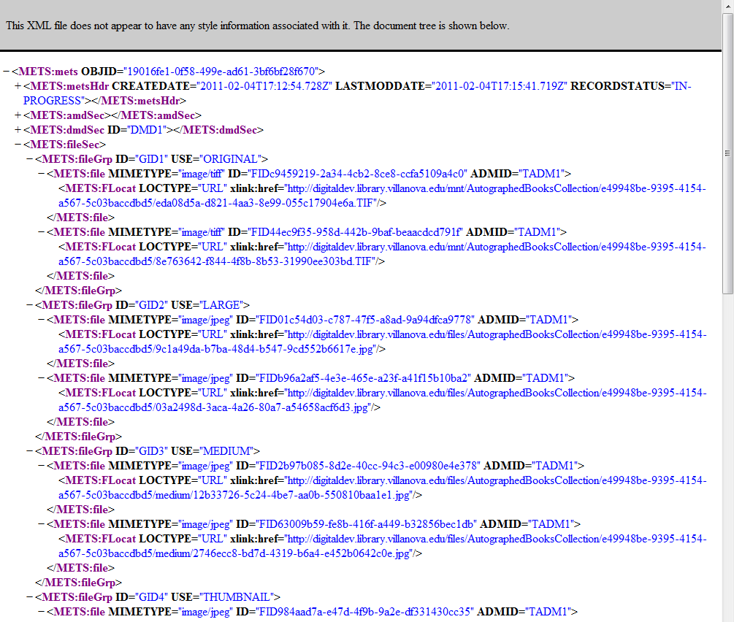

Slide 19
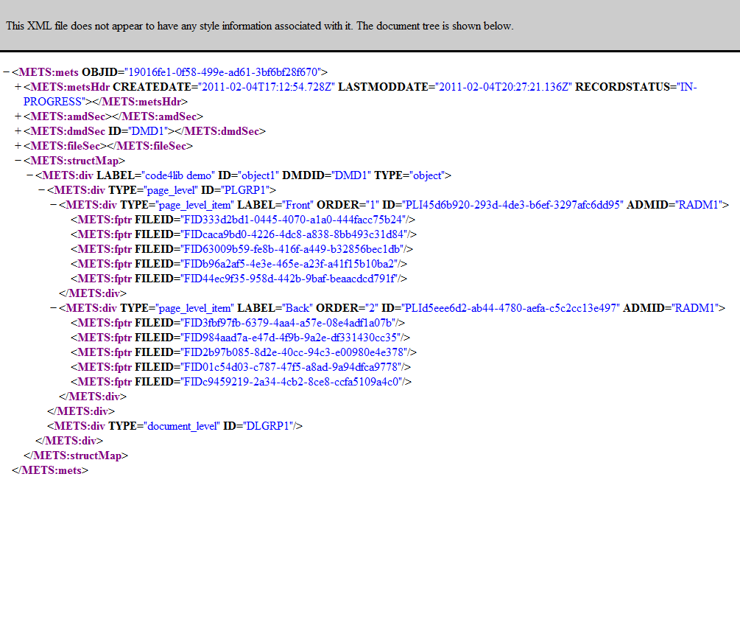

Slide 20
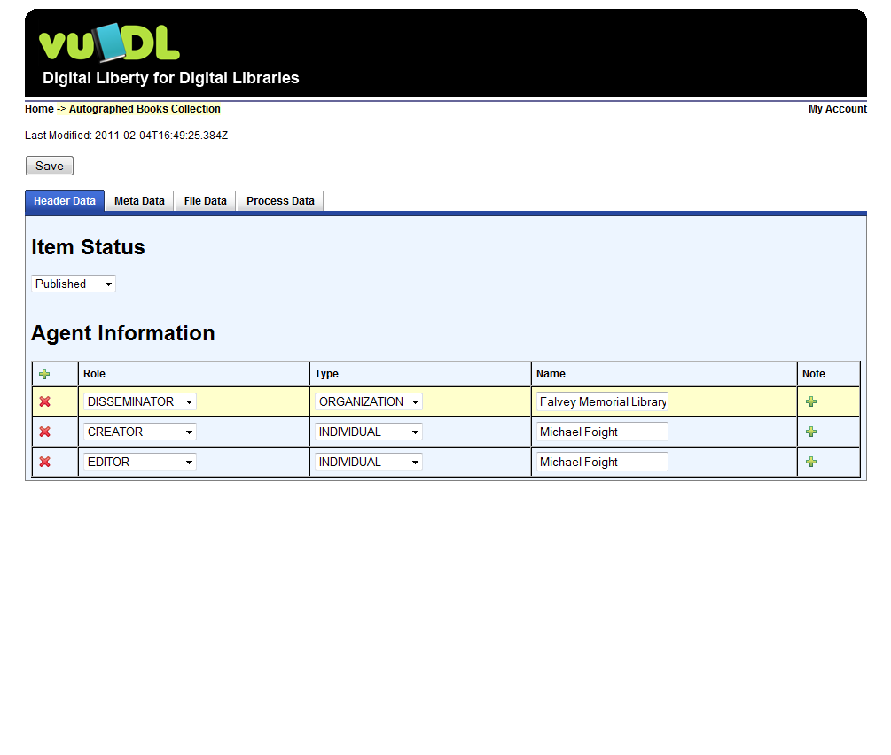
Metadata - <metsHdr>
Completion Status
Agent Information
  Editors
  IP Owners
  Disseminators
  Etc.

Slide 21
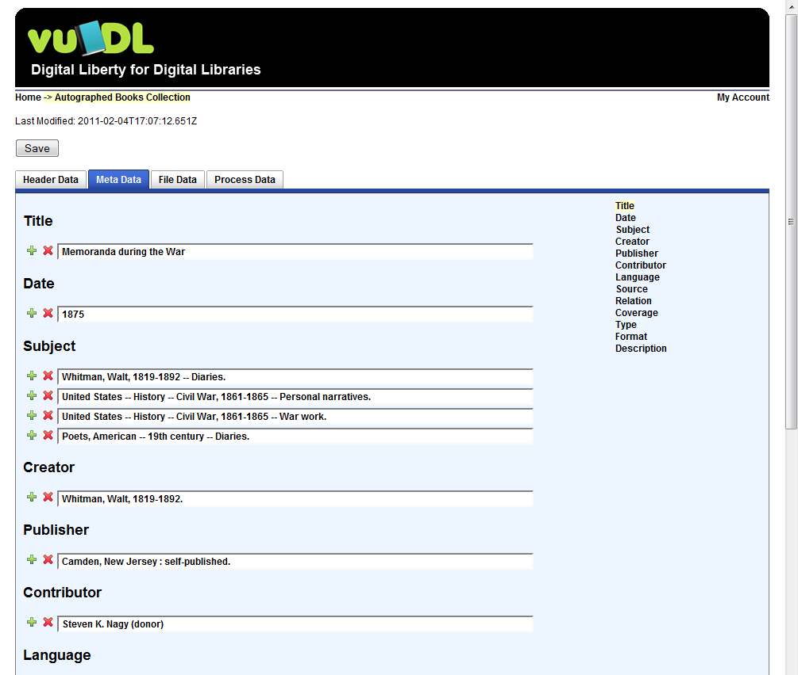
Metadata - <dmdSec>
Descriptive Metadata
Dublin Core (DC)
Looking to expand this area to other descriptive standards

Slide 23
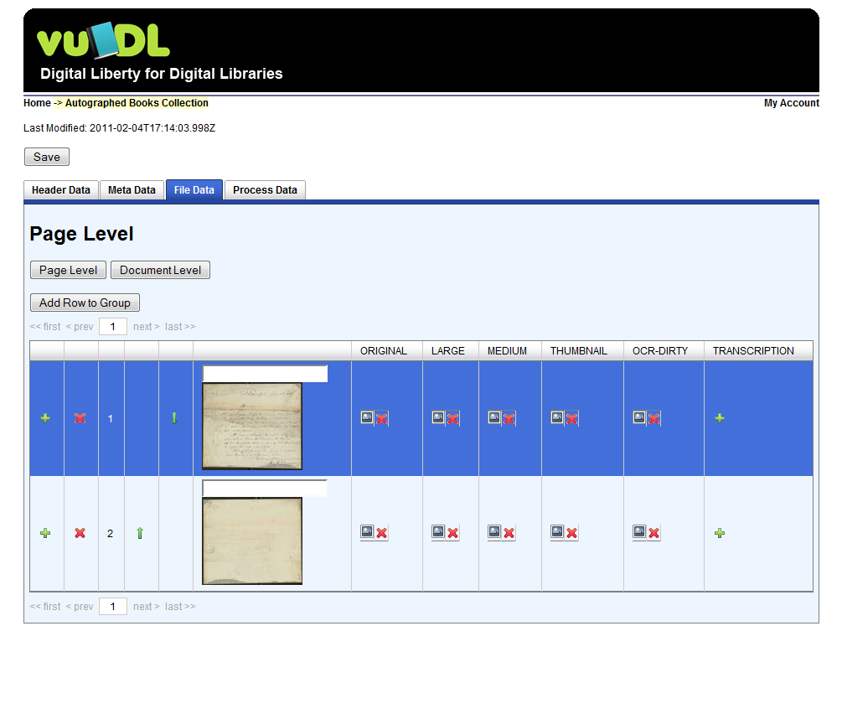
Metadata - <fileSec> and <structMap>
Physical description
Control Order
Add / Delete files
Edit Labels

Slide 25
Metadata - <fileSec> and <structMap>
2 levels of file association
  Page Level
  Document Level

Slide 27
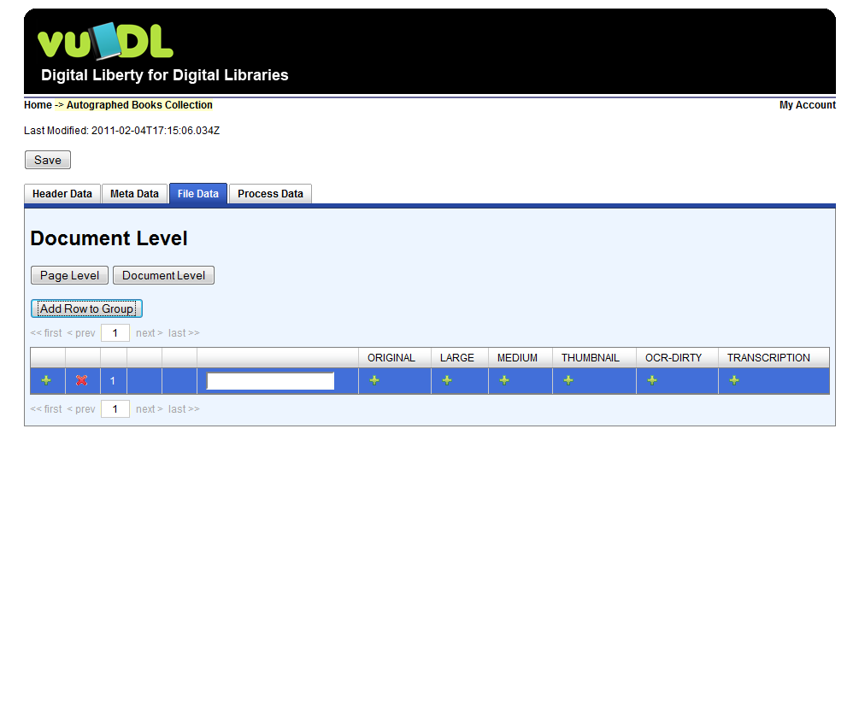

Slide 28
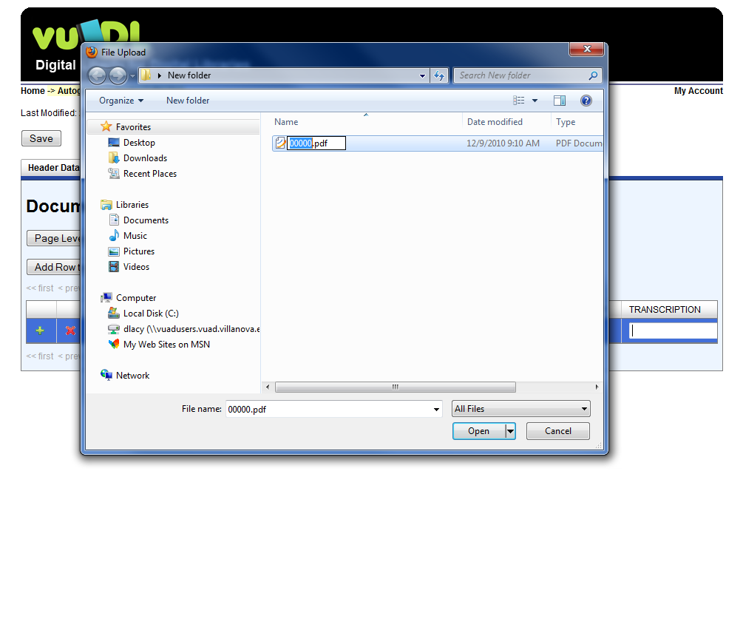

Slide 29


Slide 30
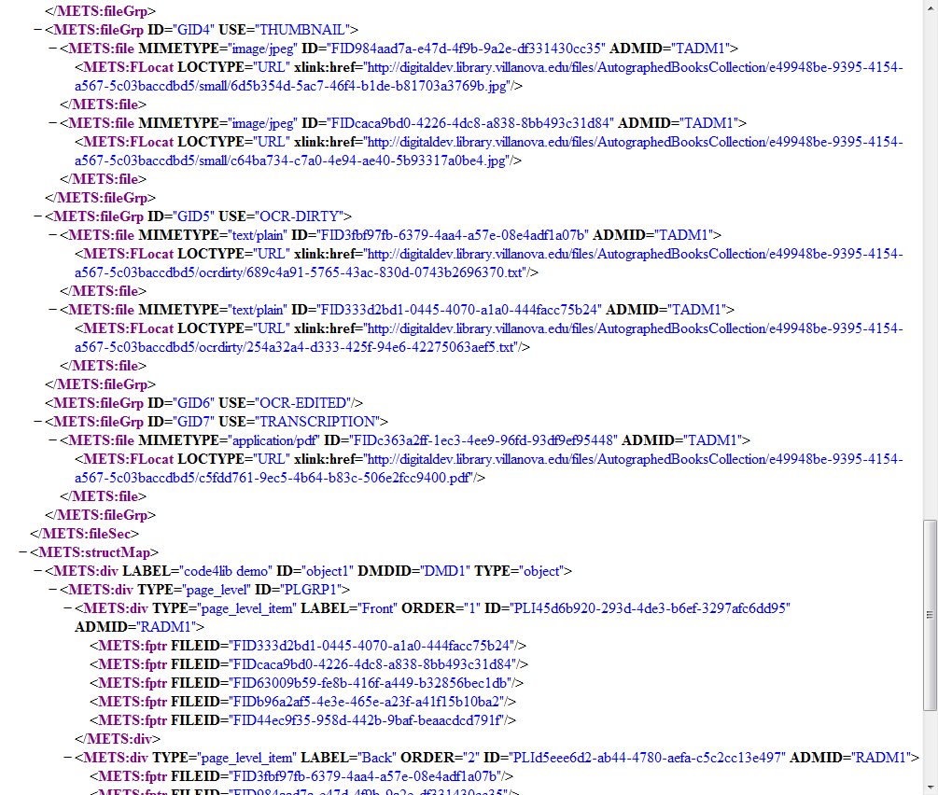

Slide 31
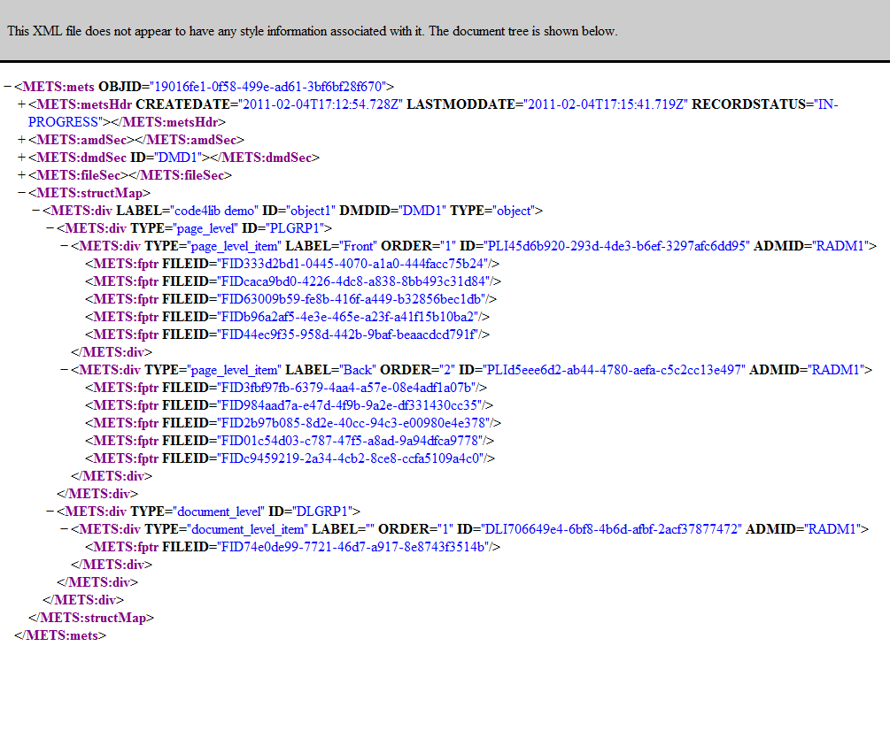

Slide 32
Problems
XML file size / Large Volumes
  Orbeon document serialization and XML processing occurs during several events
    Could disable this at cost of AJAX functionality
  Solved
    Paginate the table displaying page/line items
    Retrieve relative rows/items from repository
    Save document using XQuery Upate
Infinite METS Flexibility
  Not solved

Slide 33
Front End
Expose Content via OAI-PMH
Index into VuFind
Search Metadata and OCR/Full Text
Digital Object Viewer and Page Turner
  Page items
  Document items

Slide 34
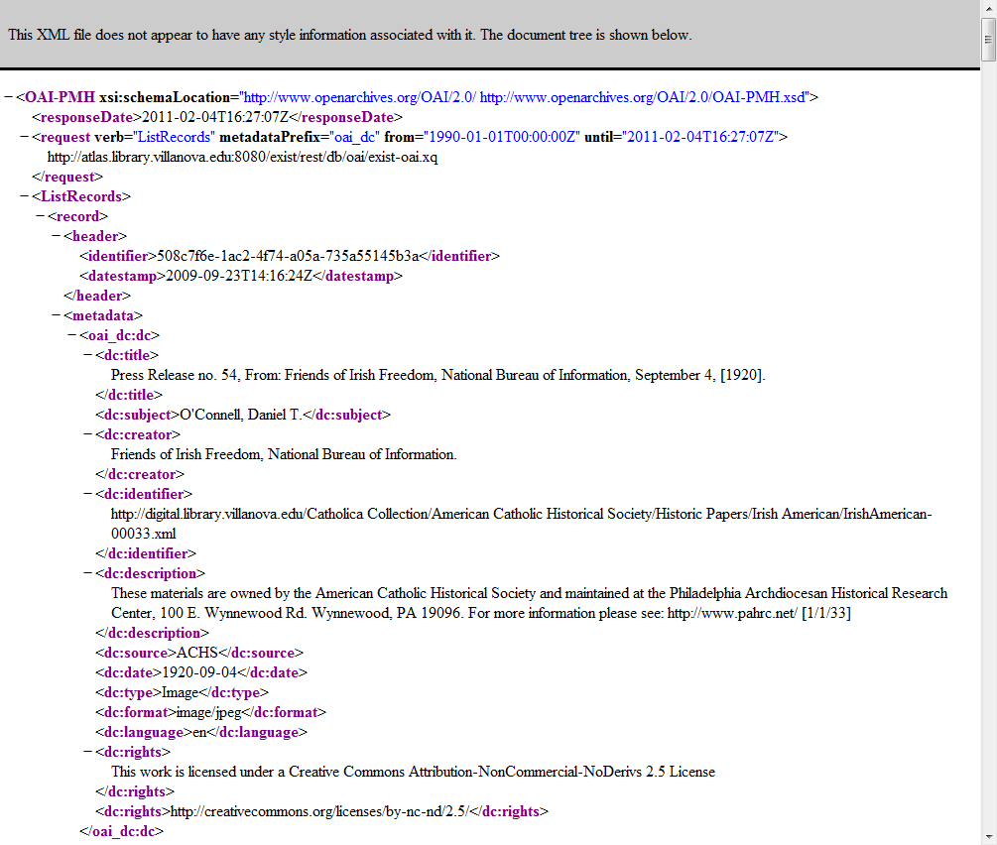
OAI-PMH Server
Written in XQuery
METS or DC

Slide 35
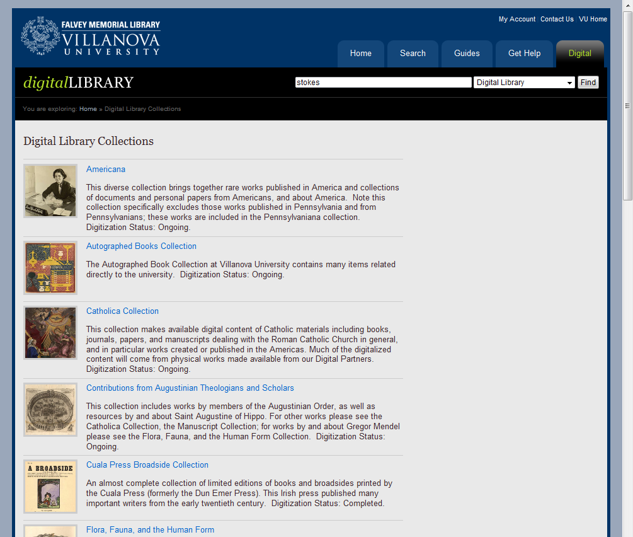

Slide 36
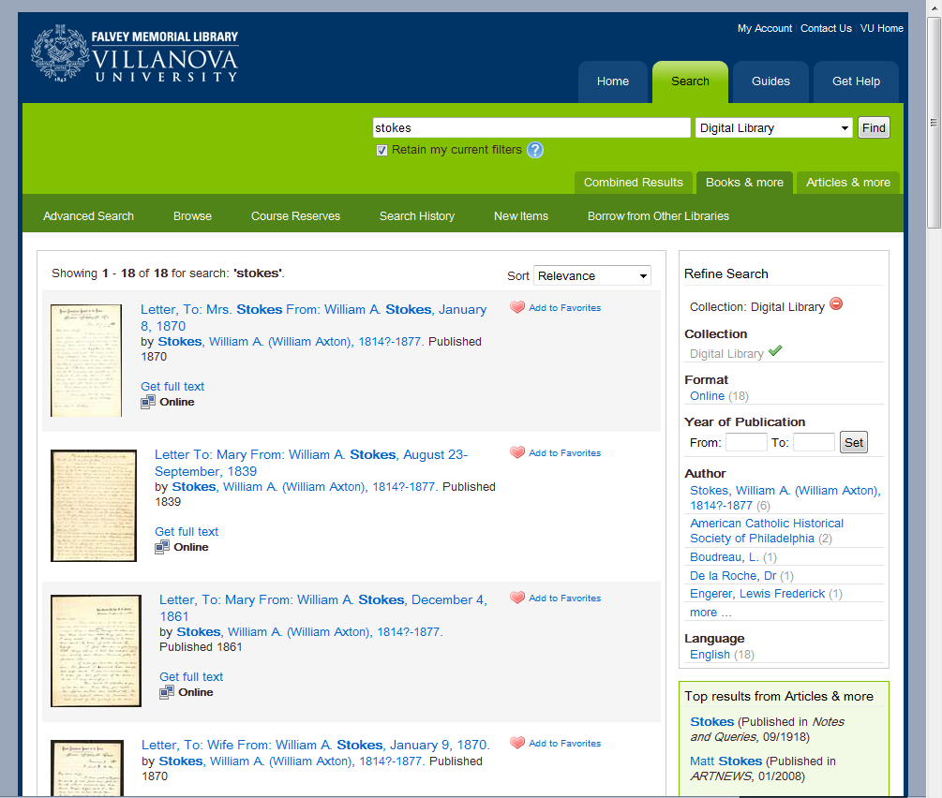

Slide 37
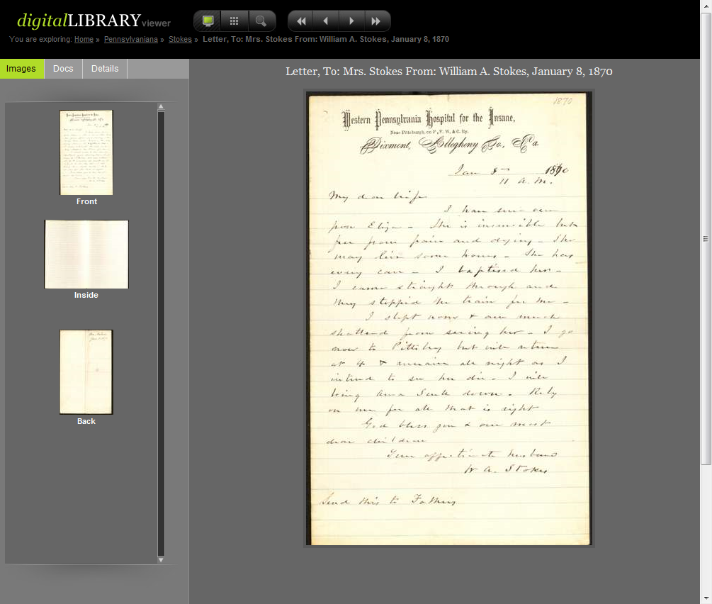

Slide 38
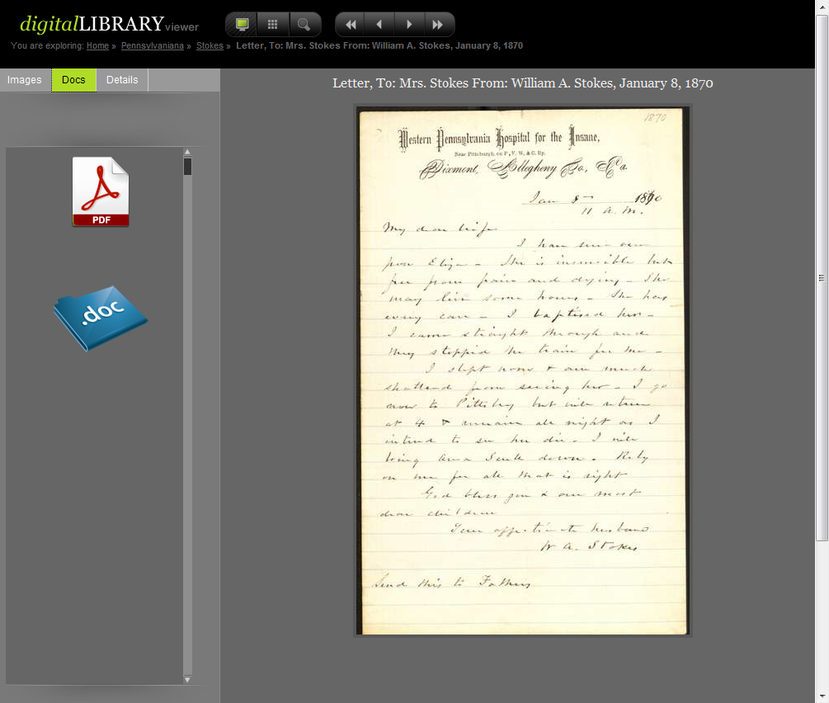

Slide 39
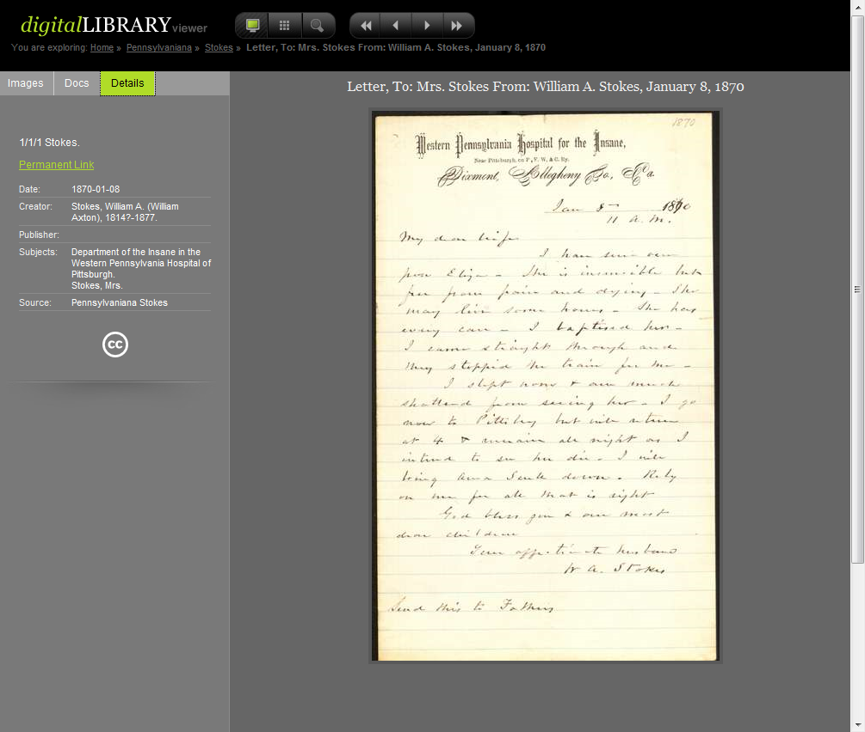

Slide 40
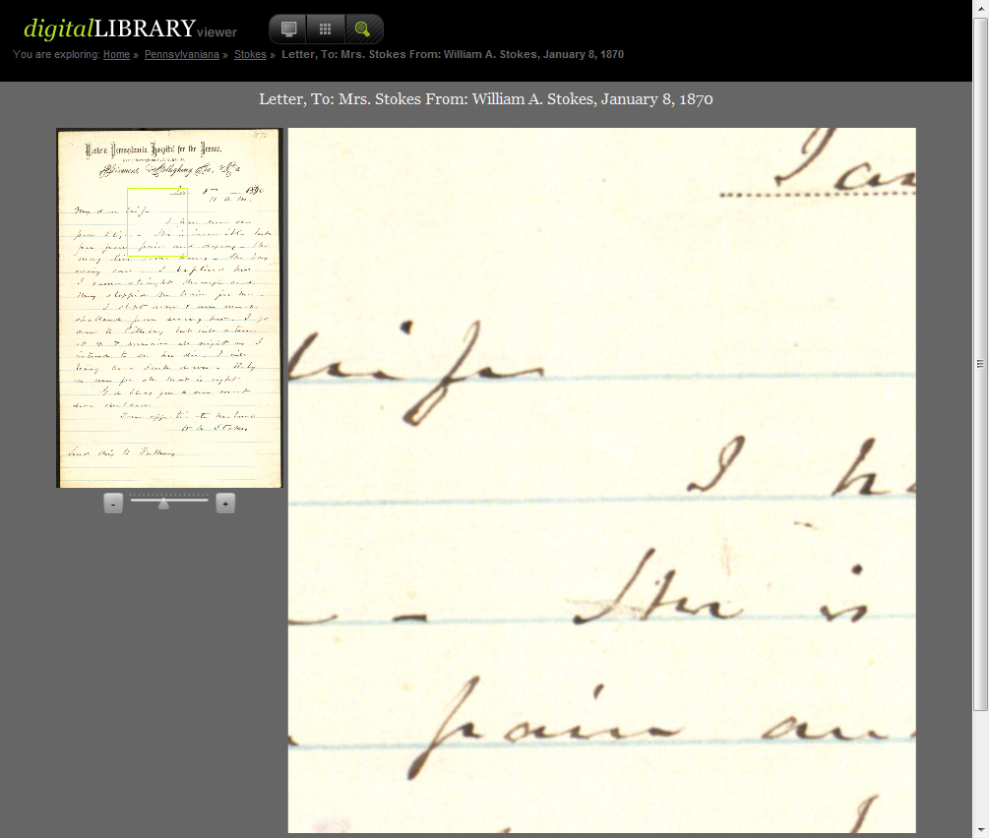

Slide 41
Roadmap
Incorporate Other Metadata
  MODS, TEI, PREMIS
Breakout METS Metadata Editor
Alternative Repository Integration
JPEG2000 Support
Document Delivery (PDF wrappers, ePub)
Logical <structMap>

Slide 42
Roadmap
ContentDM Migration

Slide 43

Coming April 2011
David Lacy
Villanova University
david.lacy@villanova.edu

